Slide 1
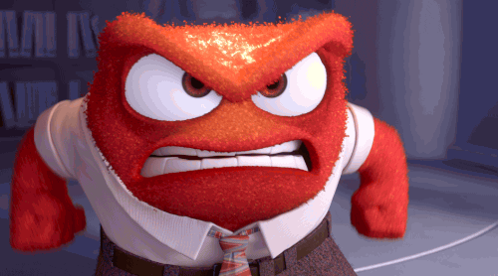
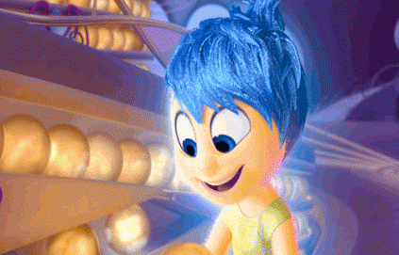
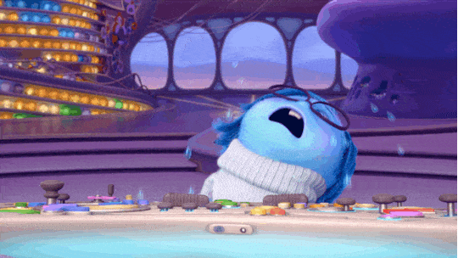
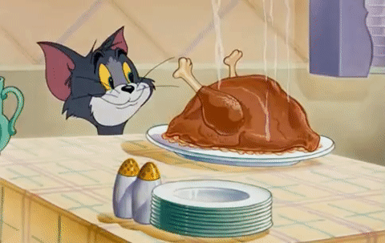
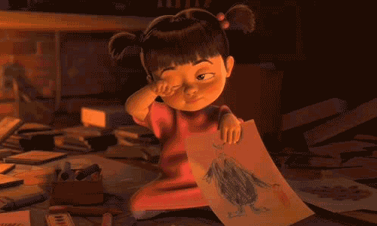
Unit 1 Quiz
Class: No: Name:
1
2
3
5
6
7
4

Slide 2
Draw a simple picture and
make sentences (一問句一答句).
Draw a simple picture and make sentences.
I
you
he
she
it
we
they
am
is
are

